Slide 1
Process-control improvements
The following work was completed to strengthen process control:
  A mass flow meter and a sight glass were added on the iodine-solution transfer line.
  Supplemental verification of the synthesizer system low-temperature limit was completed.
  Synthesizer software was improved, including the reports and the displays.
Principal improvements made at the client’s request:
  Operator confirmation was added for waste discharge and system transfer. The tuning-fork level switch and the PLC software were modified and verified.
  Peristaltic-pump tubing is not compatible with prolonged DIC/DIPEA contact, so transfer was changed to a metering pump.
  Process piping, the deprotection preparation vessel, and ancillary equipment were passivated and inspected, then cleaned and tested.

Slide 2
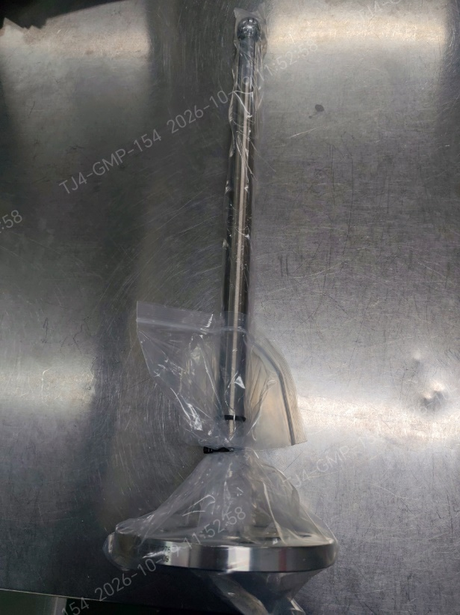
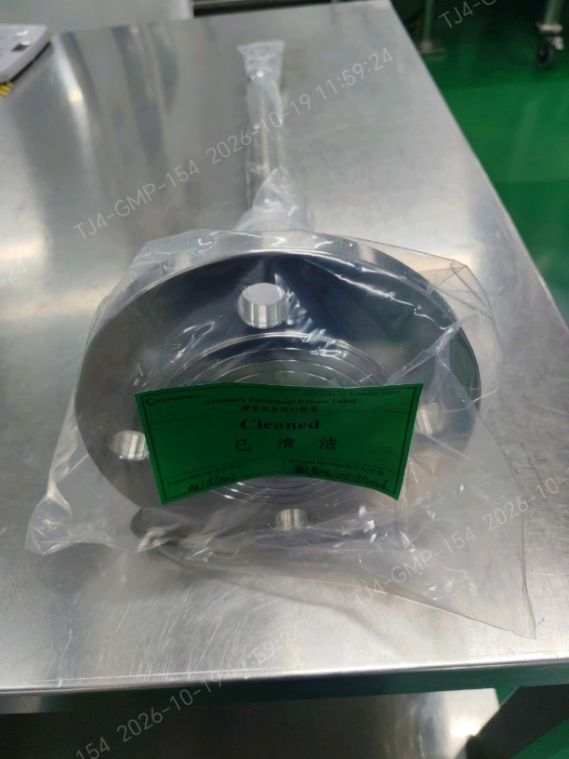
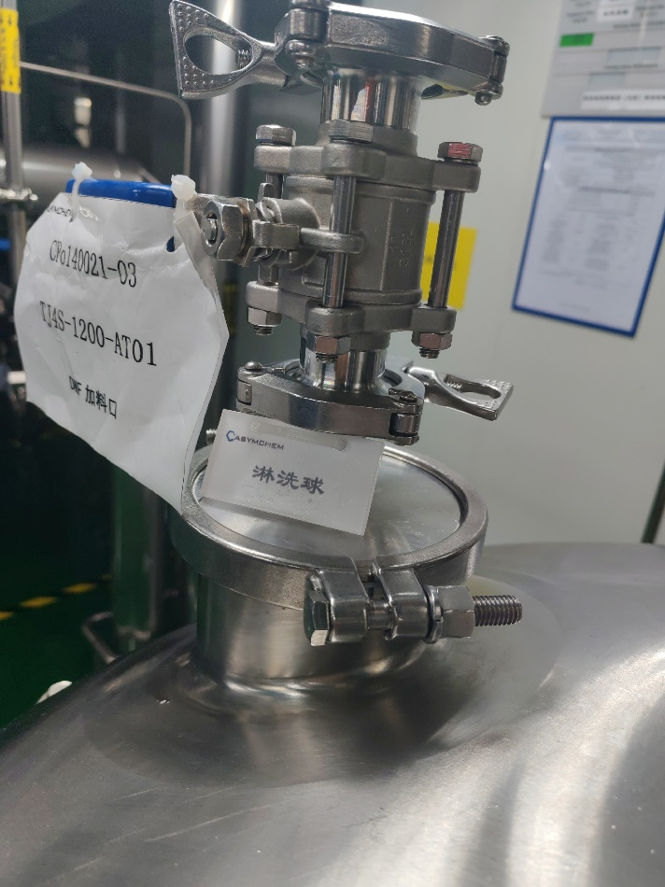
Spray-ball installation
1. Spray-ball installation, coverage test, riboflavin cleaning, and particulate check for AT09/AT01.
ASYM:
1. A stainless steel spray ball was used for the spray coverage test on mixing vessel AT09. Iodine is not compatible with prolonged stainless-steel contact, so this spray ball will be used only as a temporary accessory and will not remain in the vessel.
2. A PTFE spray ball has been purchased for mixing vessel AT09, following Lilly's recommendation and material-compatibility assessment. Given the project timeline, we recommend a trial run and completion of the supplemental spray-coverage verification and cleaning confirmation before this vessel is used for the project.
Proposed completion date: 10/20/2026
3. Mixing vessel AT01 is equipped with a spray ball and has completed spray coverage testing. The missing on-site identification tag has been corrected.
Fixing the spray ball in place would add 2 days for verification and cleaning. We recommend keeping the current rinse method.
Verification Plan and Material-Feed Schedule Evaluation
Plan | 20 | 21 | 22 | 23 | 24 | 25 | 26
Plan 1 | Rinse coverage | Iodine trial |  | CMa | Feed
Plan 2 | Iodine trial |  | CMa | Feed
TJ4S-1213-AT09Dedicated spray ball
TJ4S-1200-AT01

Slide 3
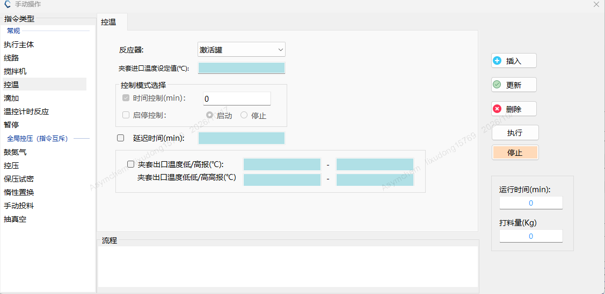
SPPS option review
2. Add high-high and low-low jacket-temperature alarms for synthesizer SY16 to the PLC.
Evaluation of each plan
1. Plan 1 provides audible and visual alarms for high-high/low-low limits, together with high/low pre-alarms; personnel respond on site once triggered, so any excursion beyond the process range is detected immediately;
Software Update
2. Plans 2 and 3
a. Provide only high/low audible and visual alarms, which management requires to be set at pre-alarm values; personnel respond on site once an alarm is triggered, and any excursion beyond the process range must be reconciled between the OR and the electronic data;
b. The MOR already records the minimum and maximum temperature for each operation, so the risk of a missed excursion is low;
Verification Plan and Material-Feed Schedule Evaluation
Plan | 20 | 21 | 22 | 23 | 24 | 25 | 26
Plan 1 | Software Upgrade | Verification |  | Iodine Trial Run |  | CMa | Feed
3. The software upgrade in Plan 1 takes 3 days. We assess that the current software, together with the MOR record of the temperature minimum and maximum, meets production needs.
We recommend keeping the current software and the MOR temperature records.

Slide 4
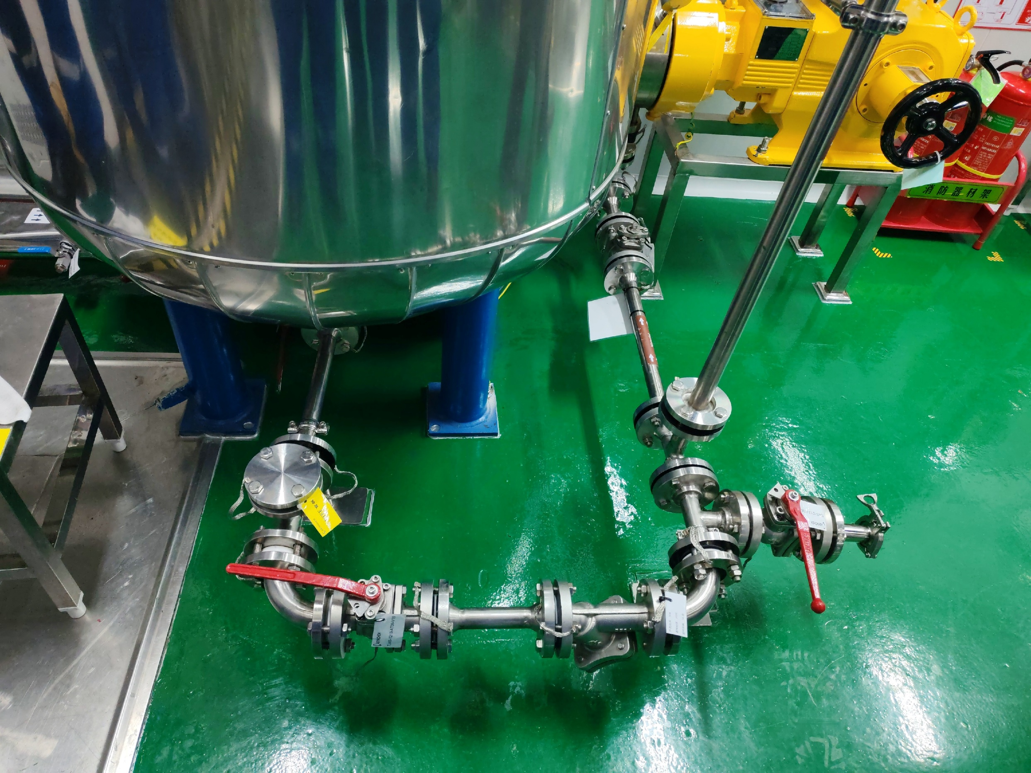
Pipeline Rectification
3. Unused side loop dead legs removal from iodine solution transfer pipeline.
ASYM: Completed. The redundant valves have been removed, and PTFE blind flanges have been installed with identification tags attached.

Slide 5
4. Iodine solution nitrogen transfer time qualification before solvent run.
ASYM: Nitrogen transfer of the iodine solution to the synthesizer will be performed during the solvent run.
Proposed completion date: 10/22/2026

Slide 6
5. Post oxidation DMF cooling time qualification by activation tank in solvent run.
ASYM: The post-oxidation DMF cooling-time test in the activation tank will be performed during the solvent run.
Proposed completion date: 10/22/2026

Slide 7
6. Pre-production equipment train rinse/swab cleanness acceptance or equivalent as stated in contamination control strategy.
ASYM:
1. Cleaning of the equipment train after passivation has been completed, and TOC testing has also been completed;
2. Elemental iodine is used during the solvent run; after the run, the equipment train will be cleaned and test strips will be used to confirm iodine residue;

Slide 8
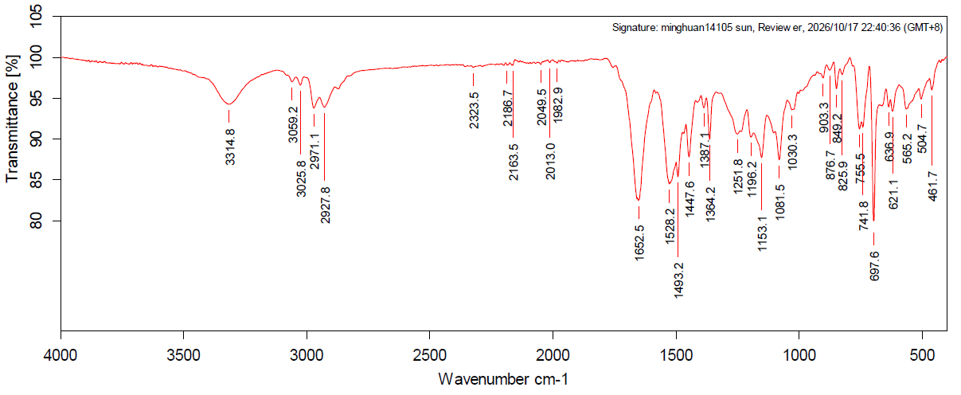
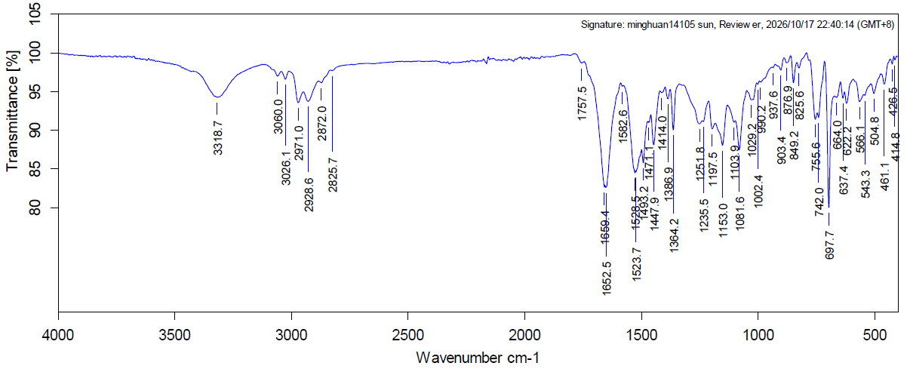
7. Investigation on contaminated sampling tool in the glovebox of L3 synthesizer SY16 and yellow solid contamination in the glovebox of L2 synthesizer SY15. Confirmation of contaminant ID is high recommended or at minimum the contamination must be confirmed to be limited to glovebox only, i.e., the possibility of contamination in the synthesizer must be ruled out.
ASYM:
1. The SY15 synthesizer most recently performed the solid-phase synthesis of 140020 step 1. The yellow solid in the SY15 synthesizer glovebox was collected and identified by IR; internal inspection of the synthesizer found no material residue, and the IR peaks of the tested sample match those of the 140020 peptide resin;
Reference Standard
Yellow Solid in the SY15 Synthesizer Glovebox

Slide 9
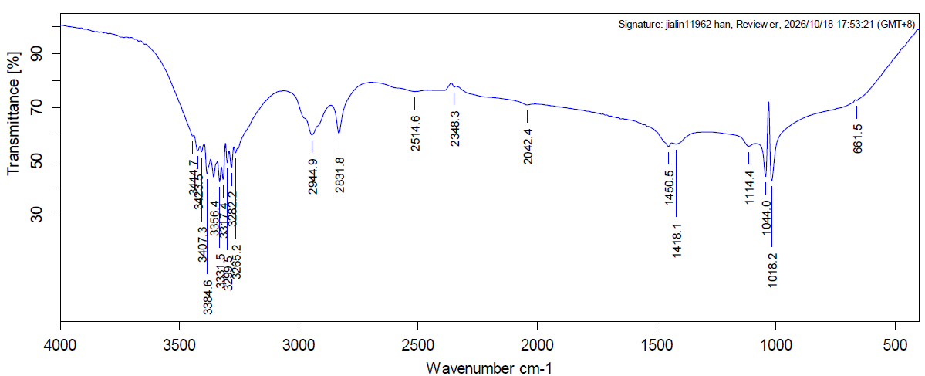
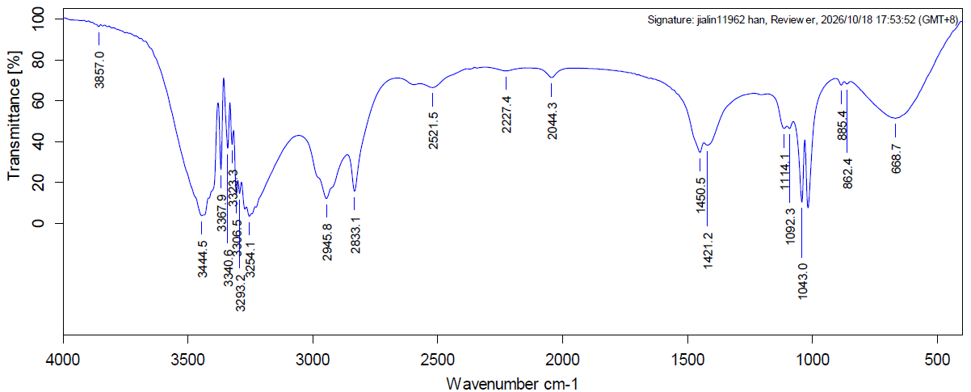
7. Investigation on contaminated sampling tool in the glovebox of L3 synthesizer SY16 and yellow solid contamination in the glovebox of L2 synthesizer SY15. Confirmation of contaminant ID is high recommended or at minimum the contamination must be confirmed to be limited to glovebox only, i.e., the possibility of contamination in the synthesizer must be ruled out.
ASYM:
2. A sample was taken from the contaminated portion in the SY16 synthesizer glovebox and identified by IR. The reference selected were substances previously used on the equipment with low volatility—DMF and ethylene glycol. Internal inspection of the synthesizer found no material residue; based on the IR spectra, the contaminant on the LDPE bag matches the characteristic peaks of ethylene glycol;
LDPE Contaminant in the SY16 Synthesizer Glovebox
Ethylene Glycol

